Slide 1
L2 report
Nguoi thuc hien: Lynta

Slide 2
L2 report
Xu ly tao report
Goi report
  Tu man hinh chi thi report
  Tu man hinh nghiep vu
  Tu command line

Slide 3
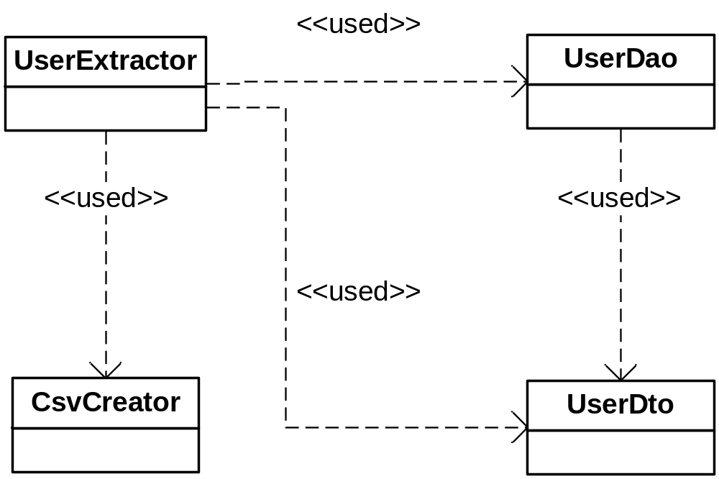
Các class chính

Slide 4
UserDto
Luu du lieu lay tu db
Fields la public, khong can tao getter/setter
Phai co full constructor

Slide 5
UserDao
Dung de trich xuat du lieu tu db
Ke thua BaseDao
Tao method trich xuat du lieu : su dung hql de lay du lieu tu db

Slide 6
UserExtractor
Thuc hien dong/mo file csv, xu ly list data nhan tu UserDao -> xuat Csv
Ke thua BaseExtractor
Override doExtract(Map aConditionMap, CsvCreator aCsv)
Khi trich xuat du lieu chi lay 1 so luong record nhat dinh (100) de tranh truong hop du lieu qua lon, khong du memory
Su dung CsvCreator de tao file Csv(appendField(), writeLine(), …)

Slide 7
UserExtractor
Khi report yeu cau cat chuoi xuat ra theo tung m byte, thi extractor khong can lam gi, viec nay form report se lam. Tuy nhien can replace ky tu xuong dong co san trong du lieu de form co the hieu, su dung : com.mitani.air.util.CsvCreator.appendField(Object, char[])
  Tham so thu 2 la ky tu can replace
  Source tham khao: com.mitani.l2.ac.cost.reporting.FieldOverheadDtlCsvExtractor
Khi trong tai lieu co chi dinh duong dan + ten file xuat csv thi phai tao batchApplication de goi toi extractor (Khi do, khong can them vao report-config.xml)
  Source tham khao: com.mitani.l2.common.finanlink.reporting.FinanLinkAutoBatchApplication

Slide 8
UserExtractor – Khi xuat Csv
Field So tien : khong co dau phay
Field ngay thang:
  Doi voi nhung extractor chi xuat csv(khong co sheet 5,6…) : neu tai lieu khong chi dinh kieu format -> QA
  Doi voi nhung extractor co xuat report : format mac dinh : YYYYMMDD

Slide 9
Report config
Khai bao report trong file report-config.xml
  Id: ma so man hinh
  Type : ten file UserExtractor (full path)
  Doi voi tsukihanashi report : phai co them param :
  <listworks drivername="Assort" />
  Tuyet doi khong commit file report-config.xml, goi mail nho ben Nhat them vao.

Slide 10
L2 report
Xu ly tao report
Goi report
  Tu man hinh chi thi report
  Tu man hinh nghiep vu
  Tu command line

Slide 11
Man hinh chi thi report
Chi can tao file jsp, struts-config
Khong can tao Form, Action, Application ma su dung ReportingForm, ReportingAction, ReportingApplication cua framework

Slide 12
Cac file chinh
Struts-config-[projectName]-reporting.xml
Frame cha (main jsp) : reportName + Frame.jsp
Frame chi thi xuat report (head jsp): reportName.jsp

Slide 13
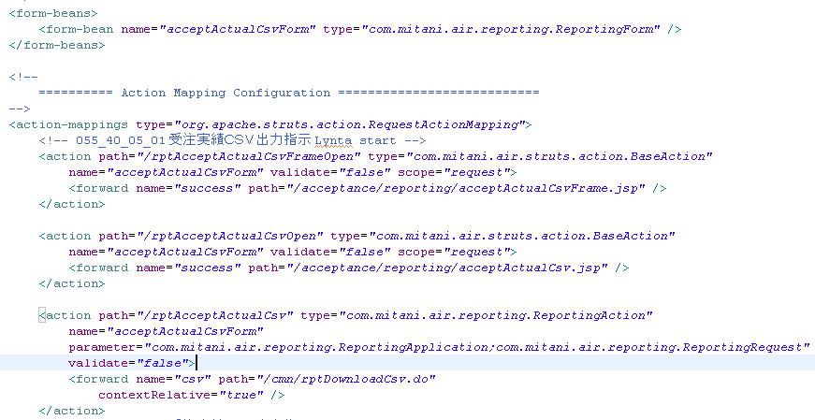
Struts-config - online report
Quy tac dat ten action:
Frame cha : rpt + reportName + FrameOpen
Frame chi thi tao report : rpt + reportName + Open
Frame thuc hien tao report: rpt + reportName
Ten form : reportName + ReportingForm

Slide 14
Struts-config – tsukihanashi report
Thuc hien report bat dong bo
(Trong tltk tieng viet có cụm tu “tra ve ket qua ngay” or “突き放し”)
VD:
<action
path="/rptProjectReport"
type="com.mitani.air.reporting.BatchReportingAction"
name="projectReportReportingForm"
parameter = "com.mitani.l2.biz.BgProcessApplication;
com.mitani.l2.reporting.BatchReportingApplication;
com.mitani.l2.biz.BatchRequest"
validate="false">
</action>
Report binh thuong :
<action
path="/rptProjectReport"
type="com.mitani.air.reporting.ReportingAction"
name="projectReportReportingForm"
parameter = "com.mitani.air.reporting.ReportingApplication;
com.mitani.air.reporting.ReportingRequest"
validate="false">
</action>

Slide 15
reportName.jsp
Su dung <ex-html:remoteSiteTitleLink> thay vi <ex-html:titleLink>
Phai include file loginUser.jspf : lay nhan vien login, dieu kien van dung …
Doi voi parameter nhap tu man hinh thi phai dat ten la value(propertyName)
Khi nhan nut xuat Csv -> submit form voi action tao report (/rptReportName.do)

Slide 16
L2 report
Xu ly tao report
Goi report
  Tu man hinh chi thi report
  Tu man hinh nghiep vu
  Tu command line

Slide 17
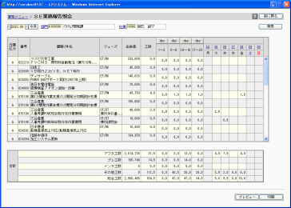
Goi report tu man hinh nghiep vu
Từ màn hình nghiệp vụ (application server) -> thực hiện single sign on(SSO) vào report server . Sau khi SSO vào report server thì luồng xử lý giống màn hình chỉ thị.
JSP màn hình chỉ thị
ReportingAction
SSO
ReportingApplication
MH nghiệp vụ
PDF, etc
Extractor
Dao
DB

Slide 18
SSO vao report server
Tren file *.jsp : them form
<html:form action="/cmn/singleSignOnAnotherSite" target="dummy">
<html:hidden property="siteId" value="1" />
<html:hidden property="path" value="" />
</html:form>
Path = “/rptRemoteReporting.do?reportId=055_01_01_01&…”
Ten action goi report

Slide 19
Strut-config
Tao action goi report trong file struts-config-[projectName]-reporting.xml
VD:
<action
path="/rptOrderFormPrint"
type="com.mitani.air.reporting.ReportingAction"
name="reportingForm"
parameter = "com.mitani.air.reporting.ReportingApplication;com.mitani.air.reporting.ReportingRequest" validate="false">
<forward name="owf" path="/common/reporting/remoteOnlineResult.jsp"
<forward name="pdf" path="/common/reporting/remoteOnlineResult.jsp"
<forward name="csv" path="/cmn/rptDownloadCsvRemote.do"
</action>
Man hinh chi thi : <forward name="csv" path="/cmn/rptDownloadCsv.do“
(2 dong duoi khong can them vao struts-config cung duoc)
<forward name="owf" path="/common/reporting/onlineResult.jsp"
<forward name="pdf" path="/common/reporting/onlineResult.jsp"

Slide 20
L2 report
Xu ly tao report
Goi report
  Tu man hinh chi thi report
  Tu man hinh nghiep vu
  Tu command line

Slide 21
Goi report tu command line
T/hợp xuất từ màn hình chỉ thị
T/hợp khởi động command line
Có method main(), có thể khởi động từ command line
JSP màn hình chỉ thị
Class khởi động xuất report
ReportingAction
BatchReportingApplication
ReportingApplication
Chung trong t/hợp khởi động command line và xuất từ màn hình chỉ thị.
Extractor
Extractor
Dao
Dao
DB
DB

Slide 22
Tao class khoi dong xuat report
Ten : reportName + batch
Ke thua com.mitani.l2.reporting.BaseBatchReporting
Cac method chinh:
  main() : khoi dong report
  getExtParamNames() : check ten param khi khoi dong (neu param truyen vao khong co trong mang tra ve cua method nay thi se bi error)
  isValidParams() : check cac param bat buoc
  createParams(): neu can truyen field “parameter” cho report thi su dung method nay
  getReportId() : thuc thi sao cho tra ve Id report.

Slide 23
Cach xac dinh cac gia tri can thiet khi goi report
Lọai màn hình | CSV | 帳票 report | 帳票 report | 帳票 report
Button | - | preview | print | -
Lọai xử lý | - | - | - | 突放 bất đồng bộ（batch）
出力方法 destination | csv | pdf | owf | <blank>
自動印刷制御 autoPrint | 0 | 0 | 1 | 0
電子保存 doElectronic | 0 | 0 | 0 | 1

Slide 24
Cac gia tri can thiet khi goi report
Ngoai 3 gia tri duoc liet ke o tren, khi goi report con can cac gia tri sau :
  reportId : chi dinh id cua report can goi
  frameName: chi dinh ten cua frame chua check nhan nut 2 lan -> de bo check sau khi ket thuc xuat report
  parameter: mang kieu String, su dung de truyen nhan parameter cho report o giai doan sau khi da xuat csv.

Slide 25
Chu y khi goi report (tsukihanashi : background)
Khi goi report tu batchApplication():
  Neu su dung reportingParts thi phai beginTransaction / commitTransaction (tu quan ly transaction).
  Neu su dung BatchReportingApplication thi khong can quan ly transaction.

Slide 26
Source tham khao
acceptActualCsv.jsp
ReveDailyRepoExtractor
ReveDailyRepoBatch

